Slide 1
Boeing Drone: 67% Build Update
Project 03
Team Hi-Jacks
Damien Brothers, Dante Faria, Jay Khunt, Colby Murphy, and Thomas Schreiber

Slide 2
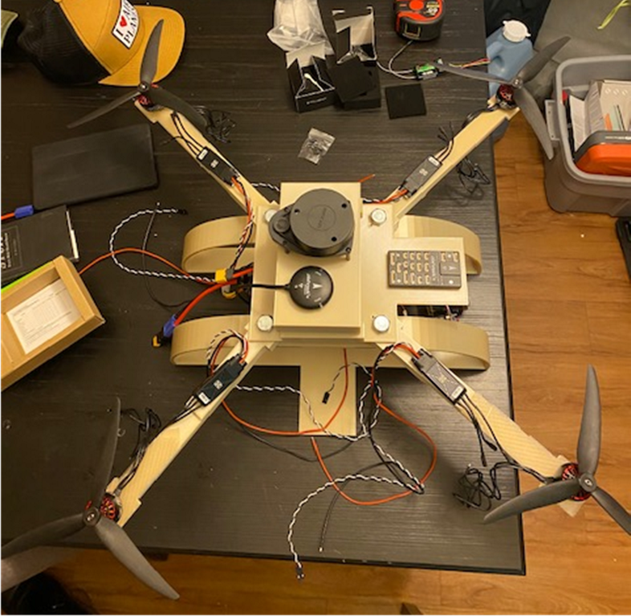
Project Description
Purpose: Design, analyze, and manufacture a 3D printed drone frame that minimizes weight and maximizes flight time using set commercially available components.
Sponsor: Boeing in Mesa AZ
Required Deliverables:
Material Optimization
Thrust to Weight Ratio
Center of Mass
Stress Testing
ANSYS
Damien, 2

Slide 3
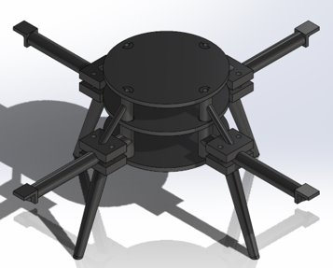
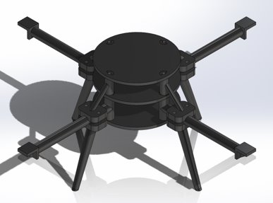
Design Efforts
Start of Semester:
33%:
Short arms
Sharp edges
Extended arms by 1"
Fillet sharp edges
Tommy, 3

Slide 4
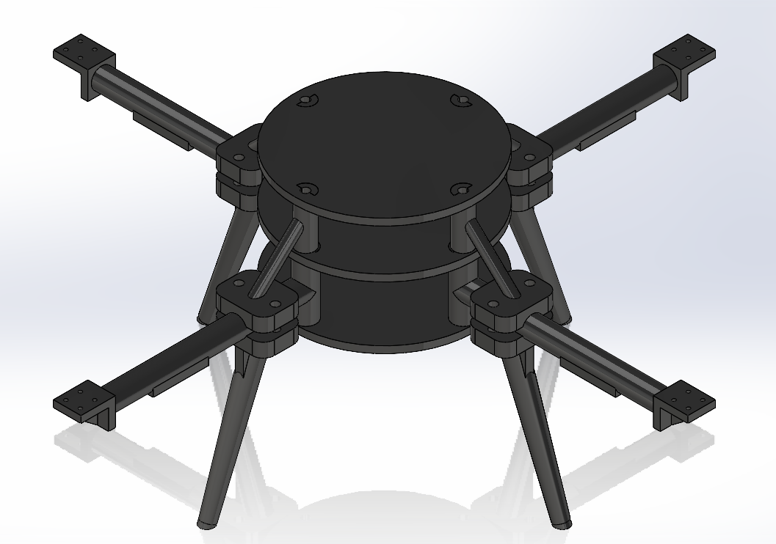
Design Efforts
67%:
Decreased arms by ½"
Extra supports
Speed controller mounts
Mounting holes
Battery divot
Tommy, 4

Slide 5
Purchasing Plan
After Crash
New propellors ordered (March 3 2023)
Final prototype parts updated and being printed
After Final 3D print- $2930 remains
Prior to Crash
Same as 33% build presentation
All parts are ordered, delivered, and on hand (Nov 2022)
3D printing for final design starting this week
Colby, 5

Slide 6
Manufacturing Plan
Manufactured (3D printed for prototype 1 and 2):
Plates
Legs
Arms
Spacers and Connectors
Assembly line:
Started with electrical connections
Connection for all 4 motors are done to flight controller
Yet to manufacture (Final Prototype):
1 plate, 4 arms, 2 Legs w/ Arm Clamps, and 2 Spacers w/ Arm Clamp
Remaining parts for Final Prototype

Slide 7
Manufacturing Plan
Part​ | PCS.​ | Item No​ | Item Description​ | Weight [g]​ | U/M​ | W-C​ | What​ | Where​ | Cost ($)​
1​ | 3​ | 22F-001​ | ONYX 3D Printed Plate W/ Key​ | 183​ | SQFT​ | FAB​ | ABS | IDEA Lab​ | 35​
3​ | 4​ | 22F-003​ | ONYX 3D Printed Arm W/Spacer​ | 108​ | SQFT​ | FAB​ | ONYX (carbon infused)​ | IDEA Lab​ | 178.12​
4​ | 4​ | 22F-004​ | ONYX 3D Printed Leg W/Arm Clamp​ | 76​ | SQFT​ | FAB​ | ONYX​ | Hubs​ | 119.08​
5​ | 4​ | 22F-005​ | ONYX 3D Printed Spacer W/Arm Clamp​ | 60​ | SQFT​ | FAB​ | ONYX​ | Hubs​ | 76.16​ ​
x1
x4
x2
x2
Drone was designed for easy fixes
Team is ready for final prototype 3D print
Will not be fixing Prototype 2
New Arms will be reinforced with Carbon fiber on Final Prototype ($)
= Now Broken
Jay, 6

Slide 8
Demonstration 1 – No Flight
Motors spinning at different times
Due to misplaced wires to the flight controller
Only seeing liftoff on one half of the drone
Drone was set to manual flight mode through QGroundControl
Controller settings set to Fixed pitch
Damien, 7

Slide 9
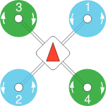
QGroundControl Settings
Correct airframe but incorrect settings.
Went with Generic Quadcopter
Critical to keep motors set up to diagram
Blue spins CCW, green spins CW.
Incorrect motor connections before fixing.
Damien, 8

Slide 10
Demonstration 2- Airborne
First successful flight off the ground
Fixed Pitch Mode
Stability Mode (Q-Ground Control)
Turn on motors quick
Propeller came loose after hitting the ground
Colby, 9

Slide 11
Demonstration 3- Propellor Loose
Propellor ejects off motor while motors are spinning up
2 motors spin in direction of tightening while other 2 spin in opposite direction
To ensure this from happening again we will need torque specs as well as temporary Loctite, possibly opposite tightening nuts
Jay, 10

Slide 12
Demonstration 4- Success
Able to take drone off the ground with minimum steering.
Need to shift weight for more control
Flew ~10 successful times inside a contained space before deciding to bring it outside.
Drone was set to stability mode.
Damien, 11

Slide 13
Demonstration 5- Failure
Catastrophic Failure about 20 feet above the Concrete
Broke 2 propellers, 1 arm, 2 legs, and 2 Trusses
Most likely the propeller came loose off the motor and caused it to death wobble
Other Issues include:
Safety mode returning motors to idle
Lack of control when trying to steer
Dante, 12

Slide 14
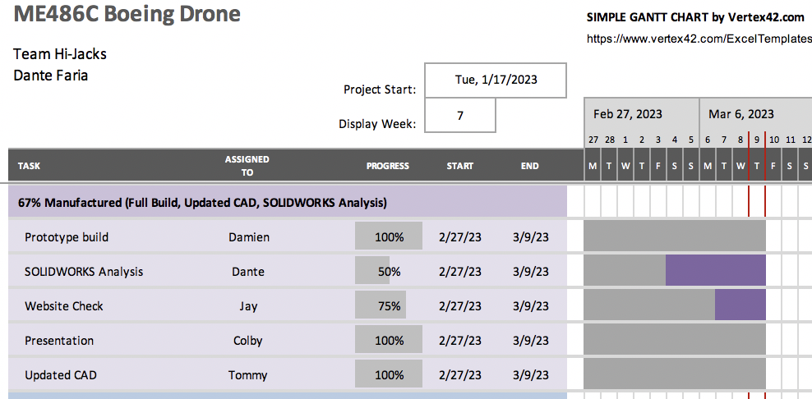
Gantt Chart Update
On Schedule
Website needs a few updates
Ordering broken parts right now to make it to meeting with Boeing
Analysis needs to be thoroughly completed before final print
Mostly Completed (waiting for final design)
Dante, 13

Slide 15
Gantt Chart Update (Future)
Dante, 14

Slide 16
Gantt Chart Update (Future)
Dante, 15

Slide 17
Gantt Chart Update (Future)
Dante, 16

Slide 18
Questions??

